Slide 1
Running PostgreSQL on Windows
March 4th, 2009
KDB

Slide 2
Objectives
Learn to use DBMS

Slide 3
Outline
Download open-source DBMS
  PostgreSQL 8.3
Install an open-source DBMS
Execute queries

Slide 4
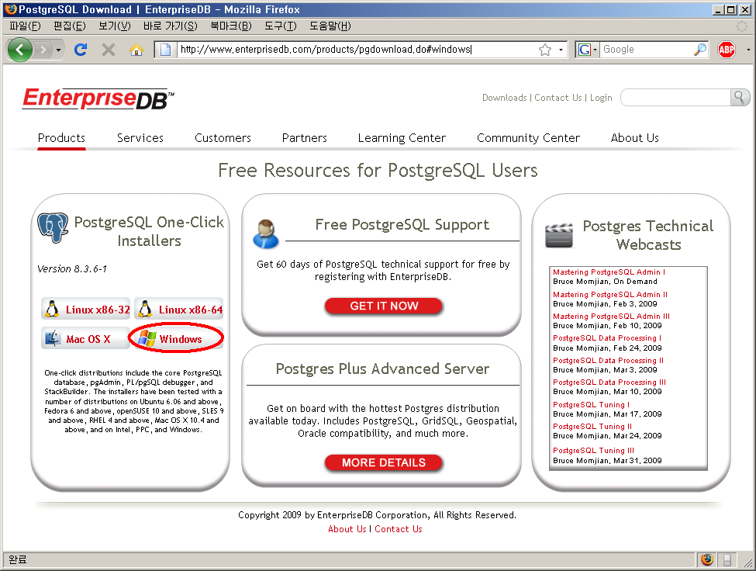
Download PostgreSQL installer
PostgreSQL 8.3.6-1 installer download link

Slide 5
Install PostgreSQL
Run ‘postgresql-8.3.6-1-windows.exe’
Setup install path
Set superuser(postgres)’s password – memorize!!
Set port number for DB server (default 5432)
Select locale – ‘Korean, Korea’
Installation
Turn off checkbox and Finish

Slide 6
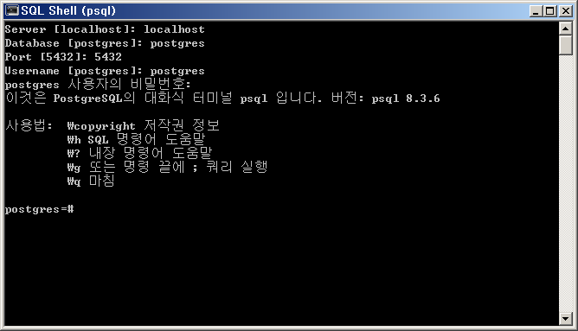
PostgreSQL Console
Windows’ start → PostgreSQL 8.3 → SQL Shell (psql)
Connecting to Database

Slide 7

Execute Query
  Query examples
    CREATE TABLE EMPLOYEE (ID INT, NAME CHAR(30), AGE INT);
    INSERT INTO EMPLOYEE VALUES (0, 'Alice', 40);
    INSERT INTO EMPLOYEE VALUES (100, 'Bob', 25);
    INSERT INTO EMPLOYEE VALUES (200, 'Carol', 30);
    SELECT * FROM EMPLOYEE;
    SELECT * FROM EMPLOYEE ORDER BY AGE;
    SELECT ID, AGE FROM EMPLOYEE WHERE NAME = 'Alice';
    SELECT AVG(AGE) FROM EMPLOYEE;
    DROP TABLE EMPLOYEE;
ID | NAME | AGE
0 | Alice | 40
100 | Bob | 25
200 | Carol | 30

Slide 8
psql Output Example
testdb=# SELECT * FROM EMPLOYEE;
id | name | age
-----+--------------------------------+-----
0 | Alice | 40
100 | Bob | 25
200 | Carol | 30
(3건 있음)
testdb=# SELECT * FROM EMPLOYEE ORDER BY AGE;
id | name | age
-----+--------------------------------+-----
100 | Bob | 25
200 | Carol | 30
0 | Alice | 40
(3건 있음)

Slide 9
Any Questions?

